Slide 1
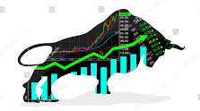


STOCK MARKET FORECASTING
Reliance Industries Limited (RELIANCE.NS)

Slide 2
PROJECT NAME: P132 GROUP NO: 2 PROJECT MENTOR: MR.RITESH MAURY
S.NO | NAME | EMAIL ID | GITHUB LINK
1 | Mrs. Sowmya Sandeep | sowmya.v187@gmail.com | https://github.com/Sowmyavirupakshaiah
2 | Mr. Nagendra Padakandla | nagendrap418@gmail.com | https://github.com/nagendrap418/project-RELIANCE
3 | Miss. Mayuri Sunil Dhumal. | mayuridhumal9815@gmail.com | https://github.com/mayuridhumal9815/Relience_price.git
4 | Mrs. Aditee Samir Dhatkar. | aditeerohilkar05@gmail.com | https://github.com/AditeeDhatkar05/Reliance_Project
5 | Nagireddy Mythili | mythilinagireddy43@gmail.com | -
6 | Amarjeet Kumar | ajeet0500@gmail.com | https://github.com/Amarjeet-1998
7 | Ms.Priti Ravikiran Patil | ppriti216@gmail.com | https://gist.github.com/priti123-1patil

Slide 3

OBJECTIVE: To Forecast a Reliance stock prices using LSTM (Long Short Term Memory ) Model.
AGENDA:
Necessary Libraries
Data Collection
EDA (Exploratory Data Analysis)
Data Understanding
Data Preprocessing
Data Visualization
Training and Testing Model
Model Building
Forecasting
Model Deployment

Slide 4
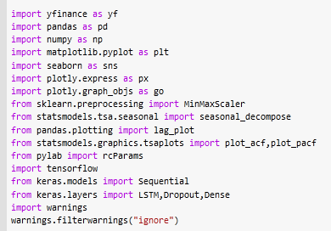






NECESSARY LIBRARIES: Here, We have used LSTM (Long short Term Memory ) Model for forecast next 10 days stock prices . And following are the important libraries which we have used for the building of LSTM model.

Slide 5

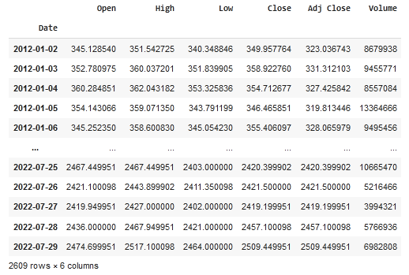
DATA COLLECTION:
We have downloaded the RELIANCE STOCK data from yfinance.
Date : Trading date of the stock.
Open :Opening price of stock on that day.
High :Highest price of the stock on that day.
Low :Lowest stock price during trade day.
Close :Closing price of the stock during trade-in
particular day.
Volume :Number of stocks traded on a
particular day.
Reliance Stock dataset

Slide 6
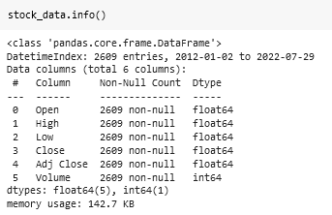
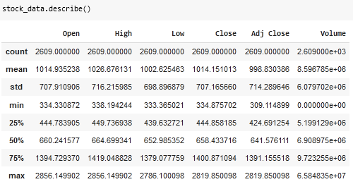

EDA (Exploratory Data Analysis):
Here , we have performed EDA.
Now, We are going to forecast just “Close” column values. Therefore we have extracted Close column from the above dataset and make a new datarame of “Close” values.

Slide 7
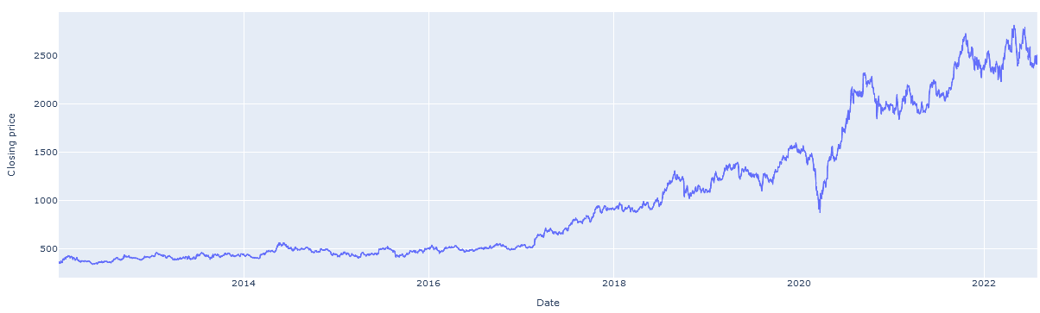
VISUALIZATION :
Here is the closing price using lineplot visualization.
Line plot:
Close Price
Date

Slide 8

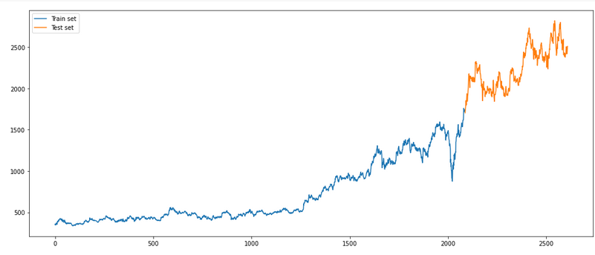
DATA SPLITING:
First of all we have to split the dataset into training and testing dataset. So that , here we take 80% of dataset for training and 20% of dataset for testing the Model.
Train
Test
Close Price
Index

Slide 9
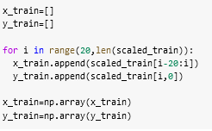
MODEL BUILDING:
Now, we are going to build a model. First we train the model ,after that we test it.
Here, we will have to train the model using training data. But we are going to forecast time series that means we have univariate dataset containing “Close” column.
Therefore we need to make X and y using “Close” column.
x_train : First 20 observations of “Close” column
y_train : 21st observation of “Close” column… and
so on upto the end of the train data (scaled train data).

Slide 10
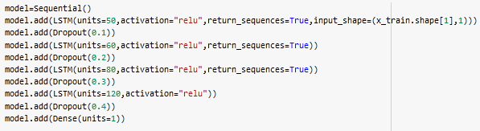

LSTM MODEL BUILDING AND COMPILATION:
For LSTM model , we need to import necessary module from Keras. Which is as follows:
Sequential :It allows to build a model layer by layer(sequentially).
* LSTM: add Long Short Term Memory layer
* Dense: add densely connected neuron networks
* Dropout rate : add dropout rate for overcome overfiting problem

Slide 11
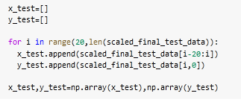

MODEL TESTING:
We have already trained the model, Now we are going to test it. So for that we have made the X and y from test dataset like we did on training dataset and created variable named x_test and y_test. And fitted in it and have predicted test values.
Test Prediction

Slide 12
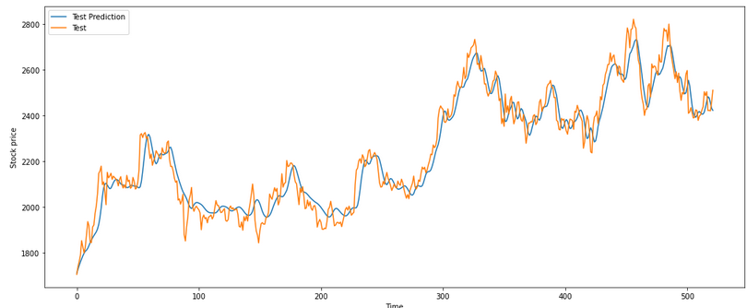
ACTUAL TEST vs PREDICTED TEST:
Test Predictions
Test
Close Price
Index

Slide 13
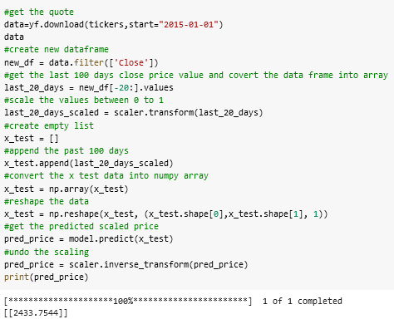
PREDICTION OF NEW DATA POINTS:
Here, we have taken same reliance data from yfinance.com and took last 20 data points as our X and we are going to predict y with the help of our model.
Predicted value

Slide 14
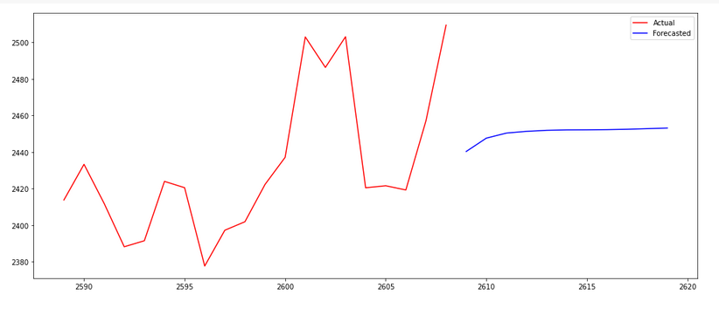
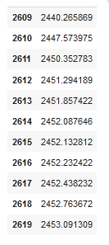
FORECASTING:
Using our model we can predict future 10 day stock prices .Here are these,
Actual
Forecasted
Close
Index

Slide 15

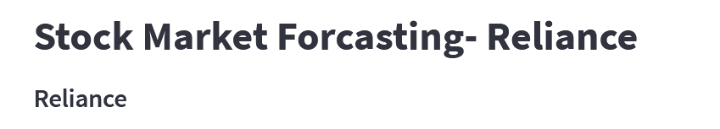
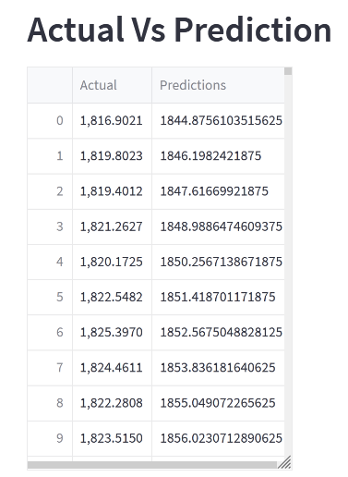
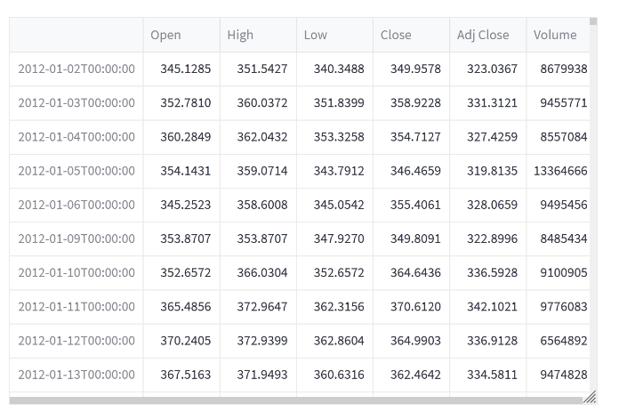
DEPLOYMENT:
Using Streamlit web application we built a Reliance stock market web application.

Slide 16
THANK YOU

